Slide 1
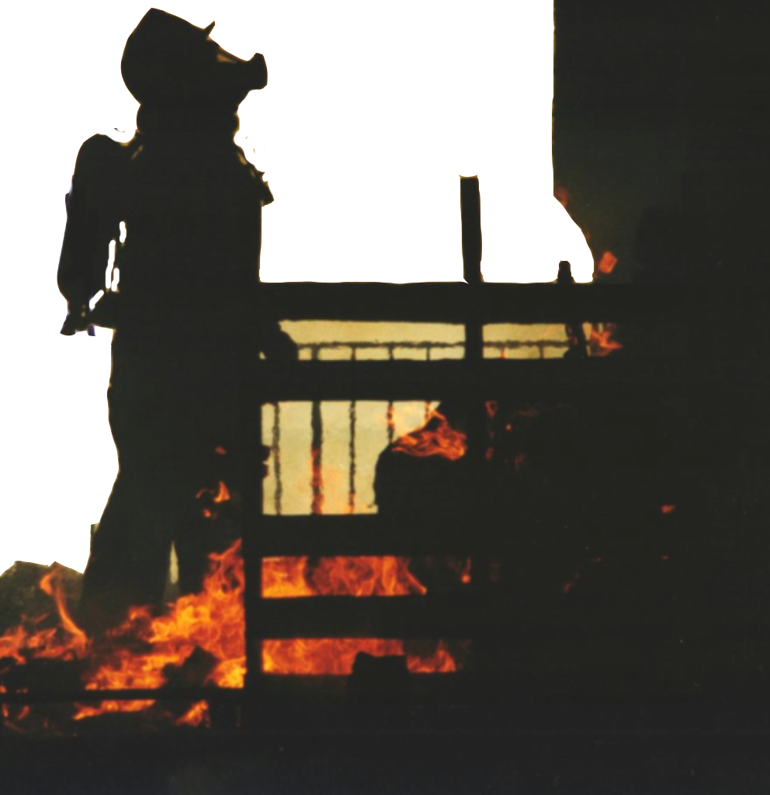
NC OSFM Lesson Plan Design

Slide 2
Previous NFPA Format
Previous NFPA formats used the objective format where the objective was written as a terminal objective and the required prerequisite knowledge and skills were written as enabling objectives.

Slide 3
The NFPA Format Now
The format used by NFPA now is in the form of the Job Performance Requirement or‘JPR’.

Slide 4
Concept of the JPR Format
The JPR identifies the minimum job performance requirements for specific fire service positions.
They are used for training design and evaluation; certification, measuring and critiquing on-the-job performance, defining hiring practices, and setting organizational policies, procedures, and goals.

Slide 5
JPR Format
Pro Qual Standards for a specific job are organized by major areas of responsibility defined as Duties.
For example, the firefighter’s duties may include fire suppression, rescue, and water supply; and the Public Fire Educator’s duties include education, planning and development, and administration.
Duties are the major functional
areas of responsibility
within a job.

Slide 6
JPR Format
The JPRs for each duty defines what the candidate must be able to do in order to successfully perform that duty.

Slide 7
JPR Format
Together, the duties and their JPRs define the job parameters; that is, the standard objective as a whole is a description of a job.

Slide 8
The JPR Has 3 Critical Components
The Task that is to be performed.
Tools, equipment, or materials that must be provided to successfully complete the task.
Evaluation parameters and performance outcomes.

Slide 9
The JPR Also Includes
Requisite Knowledge. The knowledge necessary to successfully complete the JPR.
Requisite Skills. The total number of skills an individual must possess to successfully complete the JPR.

Slide 10
JPRs and Certification
The Instructor must insure that
the candidate has the required knowledge and skill prior to evaluating him on the JPR.
This is accomplished through the instructor’s teaching methods, lesson plans, classroom work and testing.

Slide 11
Objectives
For teaching, the JPRs are in a format that is broad in nature.
The N.C. Lesson Plan objectives define the critical aspects and techniques necessary to accomplish the JPR, i.e. - to accomplish the JPR safely and effectively. But the JPR format leaves the instructor with the flexibility to design and modify the curriculum to a local or specific level based on the specific needs
of the students in the classroom.

Slide 12
Objectives
The N.C. Lesson Plans take the JPR format and converts them to an instructional objective format.
This is in the form of a Terminal and Enabling Objective.

Slide 13
3-2 Fire department Communications.
This duty involves initiating responses,
receiving telephone calls, and using fire
department communications equipment to
effectively relay verbal or written information,
according to the following job performance
requirements.
DUTY
The Firefighter I candidate shall correctly identify and demonstrate the appropriate procedures for receiving any type of report of an emergency or alarm, including the utilization of personnel alerting equipment.
Initiate a response to a reported
emergency, given the report of an
emergency, fire department SOPs,
and communications equipment, so
that all necessary information is
obtained, communications equipment
is operated properly, and the
information is promptly and accurately
relayed to the dispatch center.
Terminal
Objective
The Firefighter I candidate, placed in a position to receive communications from the public, shall correctly explain the procedures necessary for a citizen to report a fire or other type of emergency. The Firefighter I candidate shall correctly explain the procedures for receiving an alarm from the dispatch center or a report of an emergency from the public and then demonstrate the appropriate action.
JPR
Prerequisite Knowledge: Procedures
for reporting an emergency, departmental
SOPs for taking and receiving alarms, radio
code or procedures, and information needs of
the dispatch center.
Prerequisite Skills: The ability to operate fire
department communications equipment,
relay information, and record information.
Enabling
Objectives
Written and Practical Testing
Written and Practical Testing

Slide 14
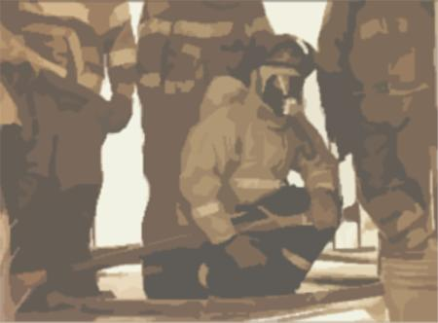
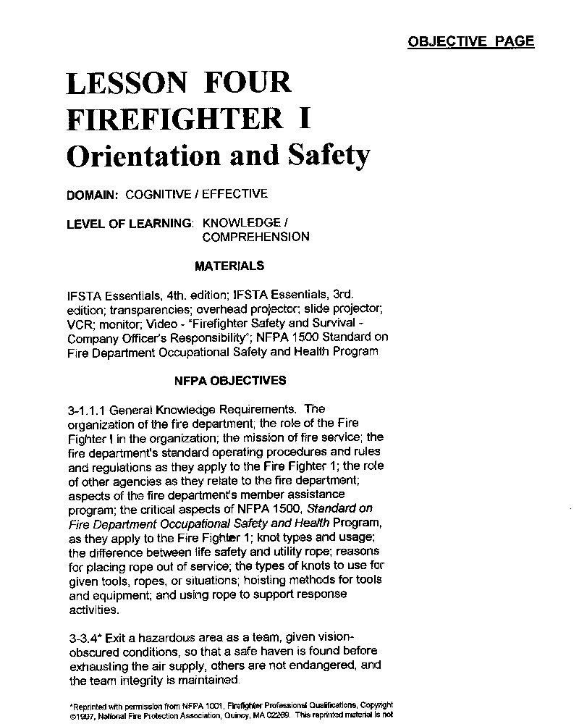
Lesson Plan Components
Title
Domain
Level of Learning
Materials
NFPA Objectives - JPRs
Terminal Objective
Enabling Objectives
Motivation Statement
Key Teaching Points
References
Applications
Summary

Slide 15
Lesson Plans
OBJECTIVE PAGE
Title
Domain
Level of Learning
Materials
NFPA Objectives - JPRs
Terminal Objective
Enabling Objectives

Slide 16
Lesson Plans
Lesson Plans
Title
Domain
Level of Learning
Materials
OBJECTIVE PAGE
LESSON FOUR
FIREFIGHTER I
Orientation and safety
DOMAIN: COGNITIVE
LEVEL OF LEARNING: KNOWLEDGE / COMPREHENSION
MATERIALS
IFSTA Essentials, 4th. edition; IFSTA Essentials, 3rd edition; transparencies; overhead projector; slide projector; VCR; monitor; Video - “Firefighter Safety and Survival - Company Officer’s responsibility”; NFPA 1500 Standard on Fire Department Occupational Safety and Health.

Slide 17
Lesson Plans
Lesson Plans
Title
The Title identifies the lesson number, the discipline being offered, the topic being discussed.

Slide 18
Lesson Plans
Lesson Plans
Title
Domain
The Domain of Learning describes the classification of learning objectives.
Cognitive - Increasing knowledge and intellectual skills.
Affective - Changing attitude.
Psychomotor - Doing the skill.

Slide 19
Lesson Plans
Lesson Plans
Title
Domain
Level of Learning
Materials
OBJECTIVE PAGE
LESSON FOUR
FIREFIGHTER I
Orientation and safety
DOMAIN: COGNITIVE
LEVEL OF LEARNING: KNOWLEDGE / COMPREHENSION
MATERIALS
IFSTA Essentials, 4th. edition; IFSTA Essentials, 3rd.
edition; transparencies; overhead projector; slide projector; VCR; monitor; Video - “Firefighter Safety and Survival - Company Officer’s responsibility”; NFPA 1500 Standard on Fire Department Occupational Safety and Health.

Slide 20
Levels of Learning
This is the required level of the
candidate’s ability or proficiency needed to
successfully perform the objective.
Knowledge
Comprehension
Application
Analysis
Synthesis
Evaluation

Slide 21
Knowledge
Asks the candidate to remember such items as facts, rules, and definitions.
Its all about remembering and being able to recall facts.

Slide 22
Knowledge
Example: Which of the following placements of portable fire extinguishers is preferred?
A. Along normal paths of travel,
including exits.
B. Near the center of every room.
C. In high risk and hazard areas only.
D. In locked metal cabinets.

Slide 23
Comprehension
The lowest level of understanding.
The candidate must use knowledge to interpret, restate, or draw conclusions.

Slide 24
Comprehension
It is preferred that portable fire extinguishers are placed along normal paths of travel because:
A. They are easier to locate for yearly maintenance.
That is where they are most accessible when needed.
Most fires occur along normal paths of travel.
D. People are trained to look there.

Slide 25
Application
Asks the candidate to use information in a variety of settings.
The candidate cannot rely on the question or the context to decide what the answer is.

Slide 26
Application
When inspecting a multiple family complex, you would like to see portable fire extinguishers in which of the following locations?
Only near the heat and air equipment.
Down in a small basement storage area.
In a heavily traveled main hallway.
Securely locked in a hallway cabinet.

Slide 27
Analysis
Asks the candidate to identify parts or elements, discover relationships, compare and contrast ideas, differentiate among facts, opinions, and conclusions.

Slide 28
Synthesis
Asks the candidate to produce something original or unique.
Rearrangement or combining of ideas to construct something entirely new.

Slide 29
Evaluation
Asks the candidate to make judgments about methods, materials, ideas, performance, or products.
The previous five levels of cognitive activity are prerequisite to making an evaluation.

Slide 30
Lesson Plans
Lesson Plans
Title
Domain
Level of Learning
Materials
OBJECTIVE PAGE
LESSON FOUR
FIREFIGHTER I
Orientation and safety
DOMAIN: COGNITIVE
LEVEL OF LEARNING: KNOWLEDGE / COMPREHENSION
MATERIALS
IFSTA Essentials, 4th. edition; IFSTA Essentials, 3rd. edition; transparencies; overhead projector; slide projector; VCR; monitor; Video - “Firefighter Safety and Survival - Company Officer’s responsibility”; NFPA 1500 Standard on Fire Department Occupational Safety and Health.

Slide 31
Lesson Plans
Lesson Plans
Title
Domain
Level of Learning
Materials
These are the items that are provided during evaluation to allow the candidate to successfully complete the task and to insure that all individuals are given the same minimal tools, equipment, or materials to be evaluated with.

Slide 32
Lesson Plans
NFPA JPRs
3-1.1.1 General Knowledge Requirements. The organization of the fire department; the role of the Fire Fighter I in the organization; the mission of fire service; the fire department's standard operating procedures and rules and regulations as they apply to the Fire Fighter I; the role of other agencies as they relate to the fire department; aspects of the fire department's member assistance program; the critical aspects of NFPA 1500, Standard on Fire Department Occupational Safety and Health Program, as they apply to the Fire Fighter I; knot types and usage; the difference between life safety and utility rope; reasons for placing rope out of service; the types of knots to use for given tools, ropes, or situations; hoisting methods for tools and equipment; and using rope to support response activities.
*Reprinted with permission from NFPA 1001, Firefighter Professional Qualifications, Copyright ©1997, National Fire Protection Association, Quincy, MA 02269. This reprinted material is not the complete and official position of the National Fire Protection Association, on the referenced subject which is represented only by the standard in its entirety.
Lesson Plans
NFPA Objectives -
JPRs
If the entire JPR is printed, permission from NFPA must be acquired.
OBJECTIVE PAGE

Slide 33
Lesson Plans
Lesson Plans
Terminal Objective
Enabling Objectives
TERMINAL OBJECTIVE
The Firefighter I candidate shall correctly identify and define in writing their responsibilities in a fire department
safety program and the elements of an incident personnel accountability system.
ENABLING OBJECTIVES
1.The Firefighter I candidate shall correctly identify in writing the firefighters’ responsibilities in a fire department safety program.
2.The Firefighter I candidate shall correctly identify in writing the elements of an incident personnel accountability system.
OBJECTIVE PAGE

Slide 34
Lesson Plans
Lesson Plans
Terminal Objective
The Terminal Objective, like the JPR objective, describes what the candidate must be able to do to be qualified in either all or part of the NFPA defined Duty.

Slide 35
Lesson Plans
Lesson Plans
Terminal Objective
Enabling Objectives
The Enabling Objectives, like the prerequisite knowledge and skills of the JPR, are the requirements that must be successfully met before a candidate is qualified in either all or part of the NFPA defined Duty.

Slide 36
Lesson Plans
Lesson Plans
Motivation Statement
LESSON 4
FIREFIGHTER I
Orientation and safety
MOTIVATION
Every year we have firefighters injured or killed in the performance of their duties. Almost all of these firefighter injuries and deaths were preventable. The fire service can ill afford to loose any personnel to death or injury. The prevention of firefighter injury or death is not an impossible goal. There are measures that we can take to protect ourselves in the performance of our duty. We must develop an understanding of safety standards and methods and apply them while performing our duties. These safety standards and methods have, in large part, been developed because of a firefighter death or injury. Please do not allow our predecessors sacrifice to have been in vain, especially where you are concerned.
Lesson 4 Page 1 of 4

Slide 37
Lesson Plans
Lesson Plans
Motivation Statement
The Motivation statement describes to the Instructor and the candidates the necessity to learn and understand the objectives and tasks that will be presented.
Why is it important for the
candidates to attend this class?
Why is important that they become proficient in a particular Duty?
How does this relate to their job?
The instructor is encouraged to develop her own motivational statement to meet the needs of the individuals being
taught.

Slide 38
Lesson Plans
Lesson Plans
Presentation
Notes
Key Teaching Points
References
NOTE: The majority of the information contained in this lesson plan was acquired through the National Fire Academy Firefighter Safety and Survival; Company Officer’s Responsibility. It is recommended that instructors delivering this lesson plan, attend the North Carolina Fire and Rescue Commission Qualification Course “Firefighter Safety and Survival.”
PRESENTATION
ENABLING OBJECTIVE #1
The Firefighter I candidate shall correctly identify in writing the firefighters’ responsibilities in a fire department safety program.
1.Discuss the purpose and intent of the NFPA 1500 standard.
Reference: IFSTA Essentials, 4th. edition, Pages 21-22.
Lesson 4 Page 1 of 4

Slide 39
Lesson Plans
Lesson Plans
Presentation
Notes
Key Teaching Points
PRESENTATION
ENABLING OBJECTIVE #1
The Firefighter I candidate shall correctly identify in writing the firefighters’ responsibilities in a fire department safety program.
1.Discuss the purpose and intent of the NFPA 1500 standard.
Reference: IFSTA Essentials, 4th. edition, Pages 21-22.
Word Icons:
Discuss
Point out
List
Lesson 4 Page 1 of 4

Slide 40
Lesson Plans
Lesson Plans
Presentation
Notes
Key Teaching Points
References
NOTE: The majority of the information contained in this lesson plan was acquired through the National Fire Academy Firefighter Safety and Survival; Company Officer’s Responsibility. It is recommended that instructors delivering this lesson plan, attend the North Carolina Fire and Rescue Commission Qualification Course “Firefighter Safety and Survival.”
PRESENTATION
ENABLING OBJECTIVE #1
The Firefighter I candidate shall correctly identify in writing the firefighters’ responsibilities in a fire department safety program.
1.Discuss the purpose and intent of the NFPA 1500 standard.
Reference: IFSTA Essentials, 4th. edition, Pages 21-22.
Lesson 4 Page 1 of 4

Slide 41
Lesson Plans
Lesson Plans
Applications
APPLICATION
Divide class into small groups. Use the NFPA 1500 Standard’s worksheets, if available, to allow the candidates to evaluate their fire department against the things discussed in this lesson. If the 1500 Standard is unavailable allow each group to identify and record obstacles that may be present in their own organization(s) that would impede a safety program.
Lesson 4 Page 3 of 4

Slide 42
Lesson Plans
Lesson Plans
Applications
Applications are suggestions provided to the Instructor that will help animate the teaching process.
Good teaching involves only 15 minutes of lecture at a time and student involvement is necessary for their information retention. Instructors are encouraged to develop and use their own applications.

Slide 43
Lesson Plans
Lesson Plans
Summary
SUMMARY
1. Review the responsibilities of the firefighter as denoted by the NFPA 1500 standard and how these responsibilities are addressed within their respective fire department.
2. Re-emphasize the importance of utilizing a personnel accountability system and review the various systems in use.
Lesson 4 Page 4 of 4

Slide 44
Lesson Plans
Lesson Plans
Summary
If the instructor covers and reviews all points in the summary, the candidate should be ready to be evaluated through testing.
The summary should be used during the entire lesson to refer to key objectives that the candidates must be proficient in.
The instructor is encouraged to provide his own summary.

Slide 45
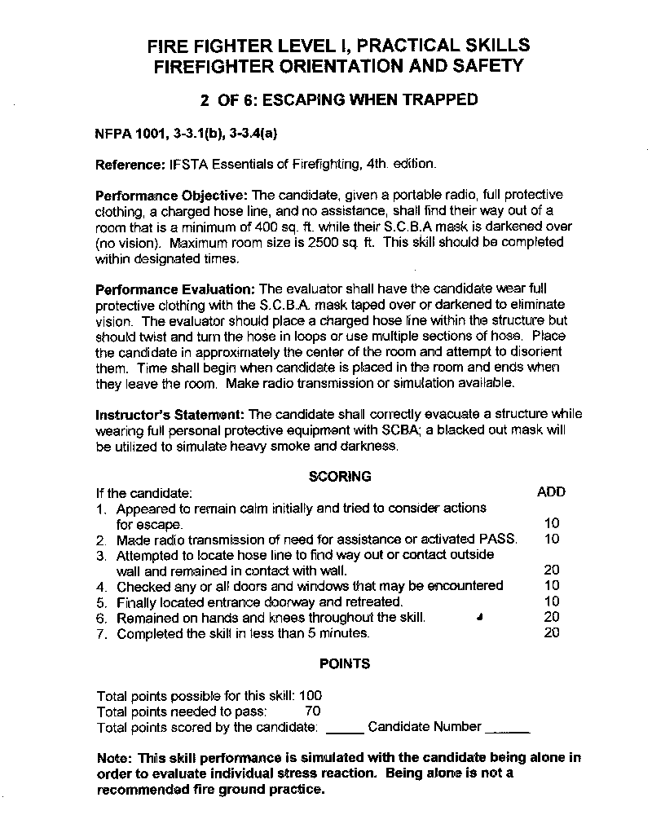
Practicals
Practical Skills
Practical #
NFPA XX JPR
Performance Objective
Performance Evaluation
Instructor’s Statement
Scoring
Points

Slide 46
Practicals
Practical Skills
Practical #
NFPA XX JPR
Performance Objective
Performance Evaluation
Instructor’s Statement
Scoring
Points
The Practicals are available to
the Instructor and should be
used during the teaching
process. Scenarios can be set
up that are similar to the
practical skill as outlined in the Performance Objective and Evaluation. The students
should practice these scenarios to become proficient.

Slide 47
Practicals
FIREFIGHTER LEVEL I, PRACTICAL SKILLS
FIREFIGHTER ORIENTATION AND SAFETY
2 OF 6: Escaping When Trapped
NFPA 1001, 3-3.1(b), 3-3.4(a)
Reference: IFSTA Essentials of Firefighting, 4th. edition.
Performance Objective: The candidate, given a portable radio, full protective clothing, a charged hose line, and no assistance, shall find their way out of a room that is a minimum of 400 sq. ft. while their S.C.B.A mask is darkened over (no vision). Maximum room size is 2500 sq. ft. This skill should be completed within designated times.
Performance Evaluation: The evaluator shall have the candidate wear full protective clothing with the S.C.B.A. mask taped over or darkened to eliminate vision. The evaluator should place a charged hose line within the structure but should twist and turn the hose in loops or use multiple sections of hose. Place the candidate in approximately the center of the room and attempt to disorient them. Time shall begin when candidate is placed in the room and ends when they leave the room. Make radio transmission or simulation available.
Practical Skills
Practical #
NFPA XX JPR
References
Performance Objective
Performance Evaluation

Slide 48
Practicals
Practical Skills
Practical #
NFPA XX JPR
References
Performance Objective
Performance Evaluation
The Performance Objective
outlines a skill with a task,
materials, and outcome that
the candidate should accomplish to demonstrate competency.

Slide 49
Practicals
Practical Skills
Practical #
NFPA XX JPR
References
Performance Objective
Performance Evaluation
The Performance Evaluation
identifies to the Evaluator the environment that the candidate should be placed in to successfully complete the skill. The Performance Evaluation standardizes the way each candidate should be scored.

Slide 50
Practicals
Practical Skills
Instructor’s Statement
Scoring
Points
Instructor’s Statement: The candidate shall correctly evacuate
a structure while wearing full personal protective equipment with
SCBA; a blacked out mask will be utilized to simulate heavy smoke
and darkness.
SCORING
If the candidate ADD
1.Appeared to remain calm initially and tried to
consider actions for escape. 10
2.Made radio transmission of need for assistance
or activated PASS. 10
3.Attempted to locate hose line to find way out or
contact outside wall and remained in contact with wall. 20
4.Checked any or all doors and windows that may
be encountered 10
5.Finally located entrance doorway and retreated. 10
6.Remained on hands and knees throughout the skill. 20
7.Completed the skill in less than 5 minutes. 20
POINTS
Total points possible for this skill: 100
Total points needed to pass: 70
Total points scored by the candidate: ___ Candidate Number___
Note: This skill performance is simulated with the
candidate being alone in order to evaluate individual stress
reaction. Being alone is not a recommended fire ground practice.

Slide 51
Practicals
Practical Skills
Instructor’s Statement
Scoring
Points
The Instructor’s Statement is the standardized message given to the candidates prior to being evaluated on the skill.
The candidate should already be familiar with the Performance Objective and Performance Evaluation.

Slide 52
Practicals
Instructor’s Statement: The candidate shall correctly evacuate
a structure while wearing full personal protective equipment with
SCBA; a blacked out mask will be utilized to simulate heavy smoke
and darkness.
SCORING
If the candidate ADD
1.Appeared to remain calm initially and tried to
consider actions for escape. 10
2.Made radio transmission of need for assistance
or activated PASS. 10
3.Attempted to locate hose line to find way out or
contact outside wall and remained in contact with wall. 20
4.Checked any or all doors and windows that may
be encountered 10
5.Finally located entrance doorway and retreated. 10
6.Remained on hands and knees throughout the skill. 20
7.Completed the skill in less than 5 minutes. 20
POINTS
Total points possible for this skill: 100
Total points needed to pass: 70
Total points scored by the candidate: ___ Candidate Number___
Note: This skill performance is simulated with the
candidate being alone in order to evaluate individual stress
reaction. Being alone is not a recommended fire ground practice.
Practical Skills
Instructor’s Statement
Scoring
Points
70% to pass

Slide 53
Practicals
Practical Skills
Instructor’s Statement
Scoring
Points
The scoring points should be reviewed by the instructor during any practice scenarios and prior to any practical testing.
This allows the candidate to understand exactly what is expected.

Slide 54
Practicals
Practical Skills
Instructor’s Statement
Scoring
Points
The practical scoring is used like a‘score card’to grade each candidate individually.
During a multi-person task practical such as ladder carries and raises, the
candidate is scored on the individual task she is performing.

Slide 55
Developed By:
NC DOI OSFM
Research & Program Development

